Slide 1
MHSAA Skiing State Finals
Data on Number of Team and Individual Racers

Slide 2
MHSAA Skiing State Finals
Question: What would it mean if individual qualifiers were allowed to compete in both events (GS and Slalom) even though they only qualified for one of the events at their Regional race?
MHSAA asked for data to understand what is happening in the races and what it might mean for future races
Data collected from 2017 – 2019 State Championships (both Division 1 and 2)

Slide 3
Example of one race: 2019 Division 1 Boys
GS
Team racers 54
Individuals 13
Total Boys GS 67
Of the 13 Individuals:
Qualified GS & SL 9
Qualified only GS 4
Slalom
Team racers 54
Individuals 11
Total Boys GS 65
Of the 11 Individuals:
Qualified GS & SL 9
Qualified only SL 2
Adding SL qualified +2
Individual total 15
New race total 69
Adding GS qualified +4
Individual total 15
New race total 69
Adds 2 SL Racers + 4 GS Racers = 6 additional racers through the courses, or ~ 9.5 minutes

Slide 4
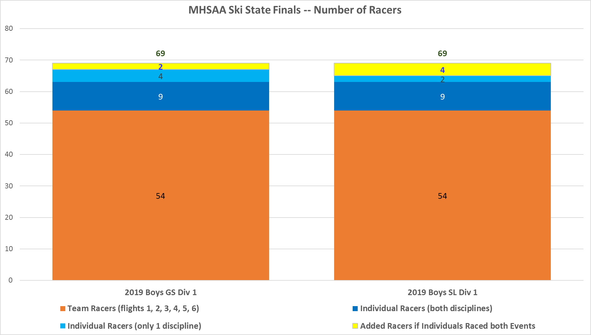
Example of one race: 2019 Division 1 Boys

Slide 5
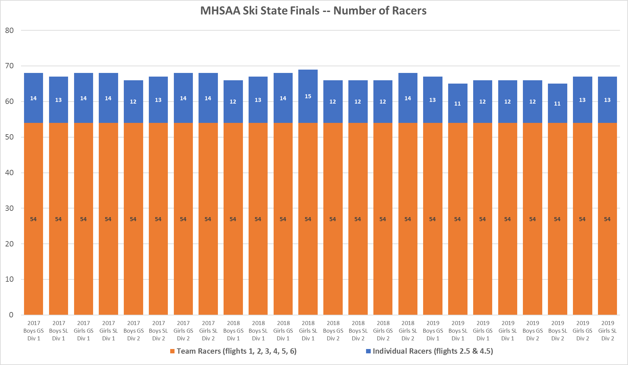
Individual racers 11 – 15
Avg = 13

Slide 6
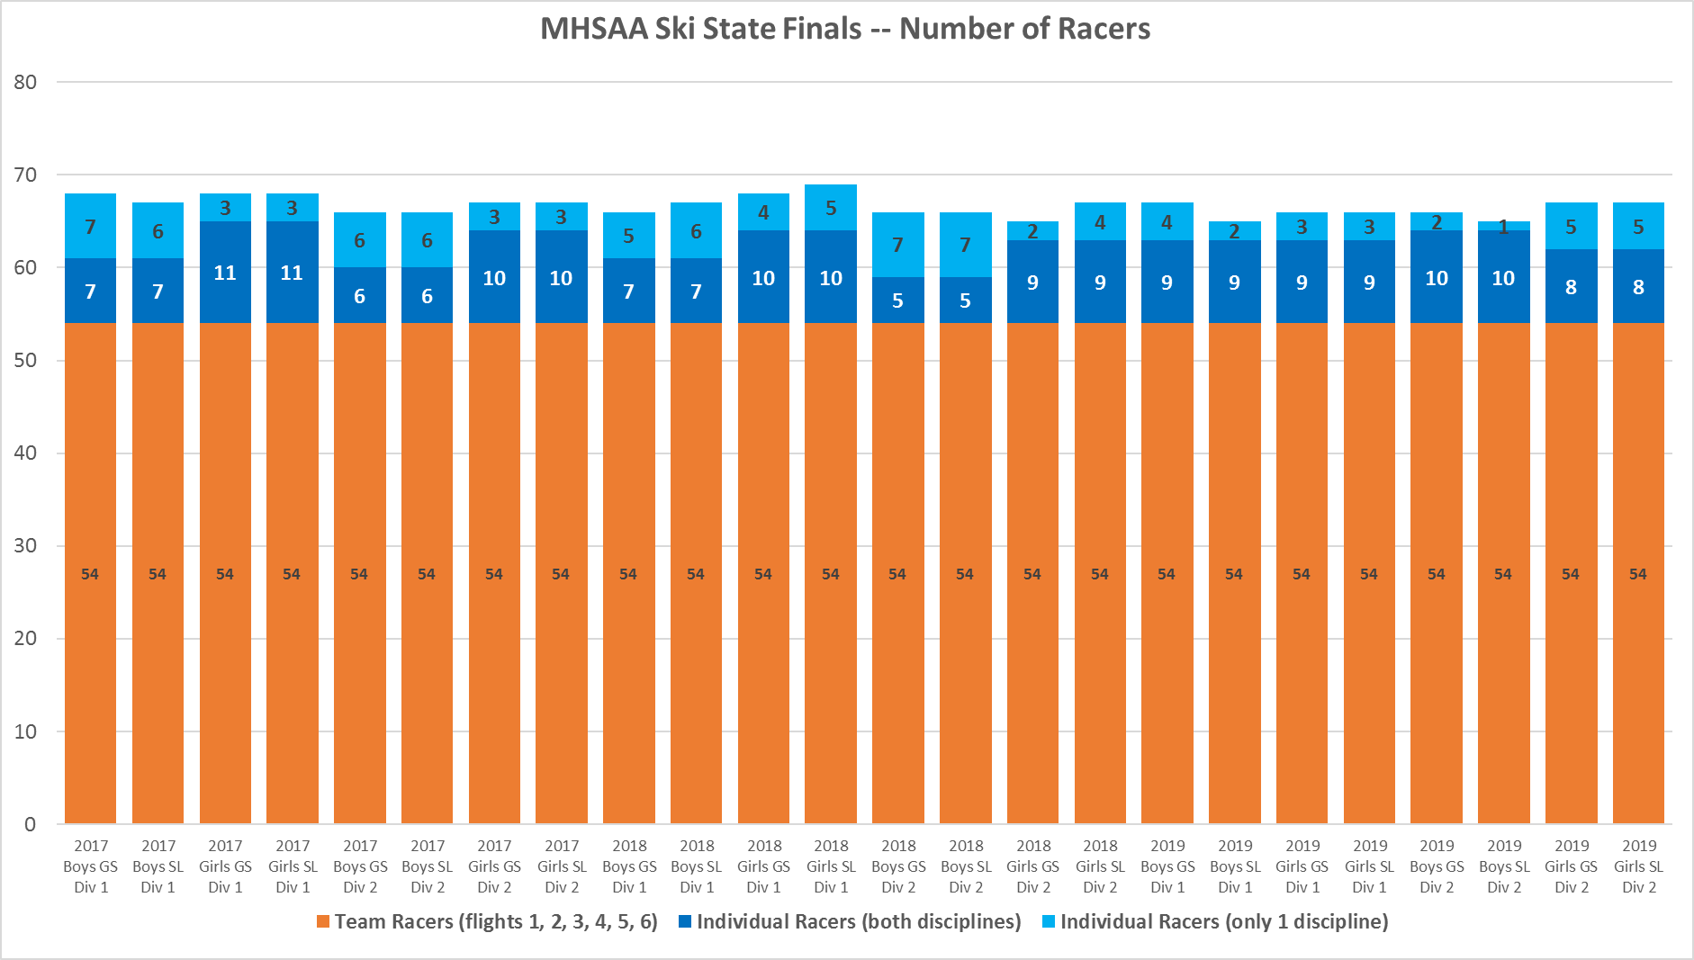
Average of 5 Individuals qualify for only one discipline
Average of 8 Individuals qualify for both races

Slide 7
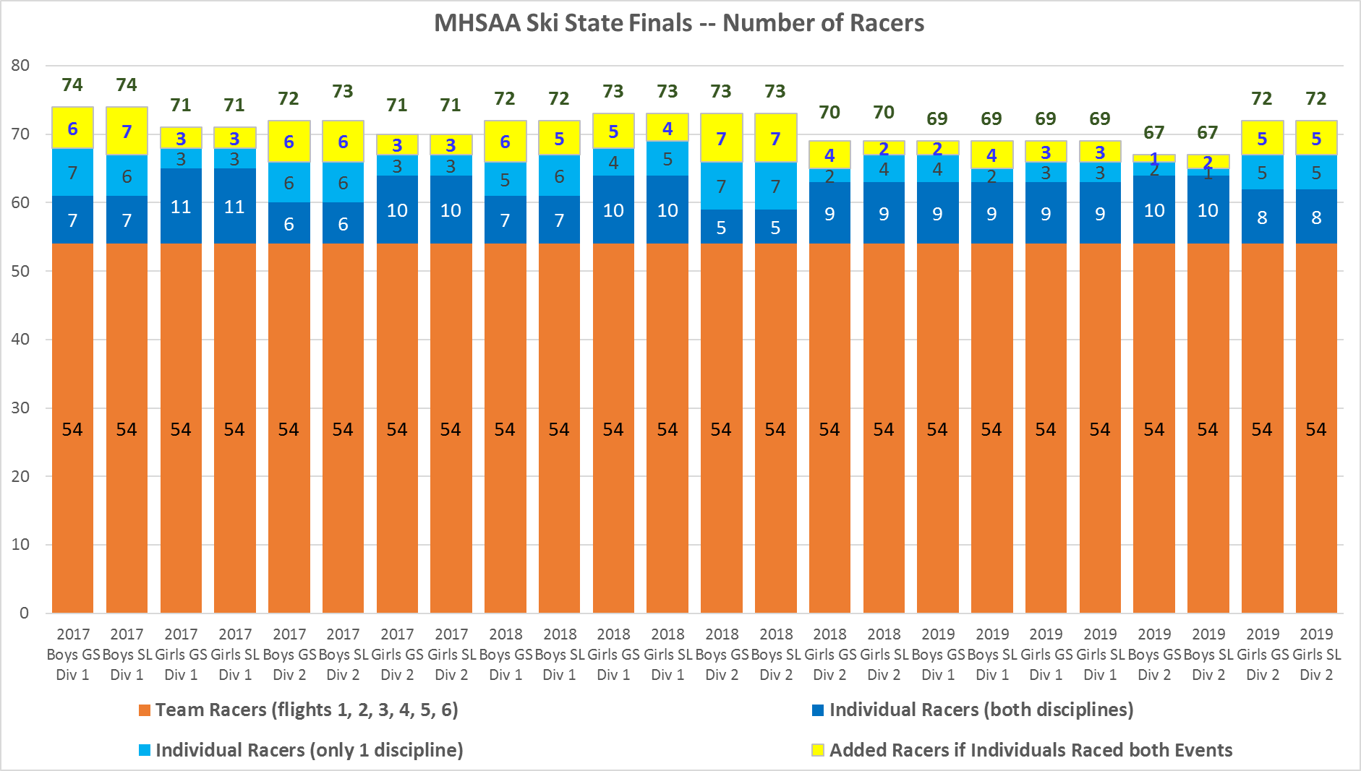

Slide 8
MHSAA Skiing State Finals
SUMMARY:
Allowing individuals to race both events would add between 1 – 7 additional racers to run through each race
This would add anywhere from 5 – 22 minutes of time to the day
Average increase would be 5 extra racers through each course, adding 14 minutes to the day

